Slide 1
風格轉換 style_transfer

Slide 2
import tensorflow as tf
def tensor_to_image(tensor):
tensor = tensor*255
tensor = np.array(tensor, dtype=np.uint8)
if np.ndim(tensor)>3:
assert tensor.shape[0] == 1
tensor = tensor[0]
return PIL.Image.fromarray(tensor)
import IPython.display as display
import matplotlib.pyplot as plt
import matplotlib as mpl
mpl.rcParams['figure.figsize'] = (12,12)
mpl.rcParams['axes.grid'] = False
import numpy as np
import PIL.Image
import time
import functools

Slide 3
下載圖片
content_path = tf.keras.utils.get_file('YellowLabradorLooking_new.jpg', 'https://storage.googleapis.com/download.tensorflow.org/example_images/YellowLabradorLooking_new.jpg')
# https://commons.wikimedia.org/wiki/File:Vassily_Kandinsky,_1913_-_Composition_7.jpg
style_path = tf.keras.utils.get_file('kandinsky5.jpg','https://storage.googleapis.com/download.tensorflow.org/example_images/Vassily_Kandinsky%2C_1913_-_Composition_7.jpg')

Slide 4
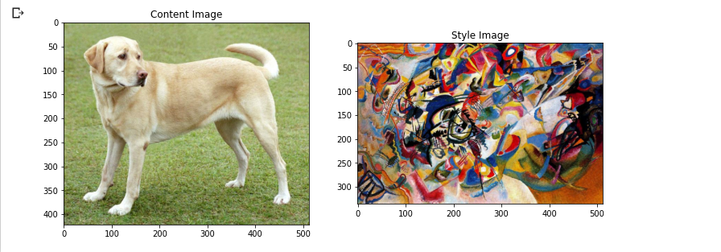
content_image = load_img(content_path)
style_image = load_img(style_path)
plt.subplot(1, 2, 1)
imshow(content_image, 'Content Image')
plt.subplot(1, 2, 2)
imshow(style_image, 'Style Image')

Slide 5
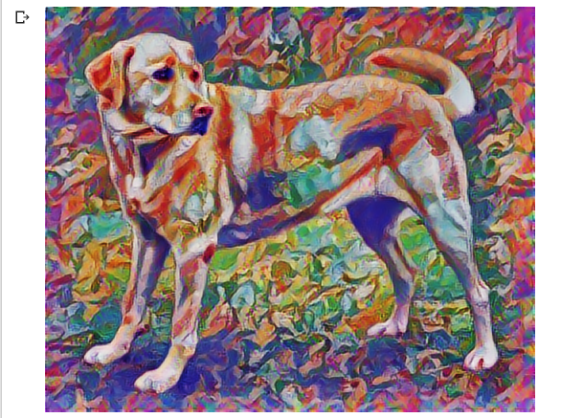
import tensorflow_hub as hub
hub_module = hub.load('https://tfhub.dev/google/magenta/arbitrary-image-stylization-v1-256/1')
stylized_image = hub_module(tf.constant(content_image), tf.constant(style_image))[0]
tensor_to_image(stylized_image)

